Slide 1
Weather and farm animals in Mongolia
Correlation between number of farm animals and climate change

Slide 2
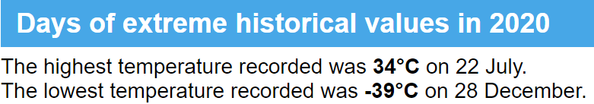
Between -30°in winter and 30°in summer
The climate is strongly continental, with long, frigid winters and short, warm summers.

Slide 3
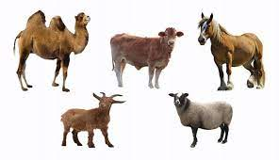
As precious as jewels : 5 snouts
The traditional herd animals of the Mongolians are horses, sheep, goats, cows and camels.

Slide 4
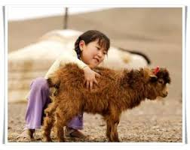
Why did I choose this topic?
A grant announced by the government for goats in 2008 is accused to improve number of goats which is ruining Mongolia’s grasslands and causing soil drought

Slide 5
Data source
Animal data (Mongolian Open data website)
https://www.1212.mn/tables.aspx?tbl_id=DT_NSO_1001_040V2&SOUM_select_all=1&SOUMSingleSelect=&LivestockPrice_select_all=0&LivestockPriceSingleSelect=_223&YearM_select_all=1&YearMSingleSelect=&viewtype=table
Weather data : (Worldbank climate knowledge portal)
https://climateknowledgeportal.worldbank.org/download-data

Slide 6
How did I proceed?
1
See if rise of average temperature is real
Compared to the rise of other animals, see if the rise of the number of goats is exceptional
4
See if there is a correlation between the rise of average temperature and the number of goats
2
3
See if there is a correlation between the rise of average temperature and the number of animals

Slide 7
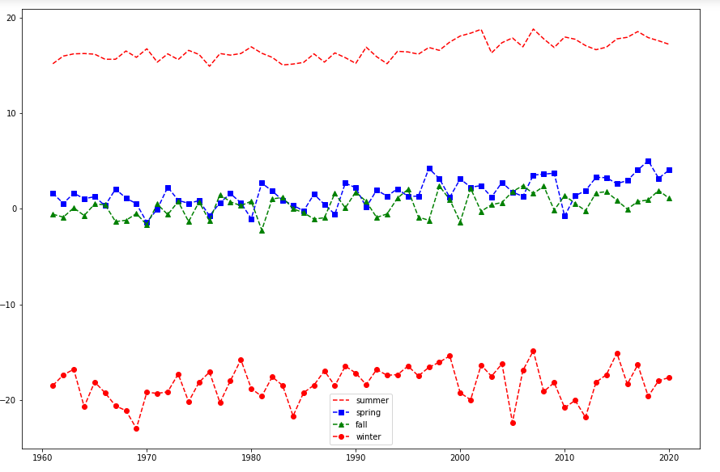
Average temperature by season since 1960
1
Correlation coefficient of temperature and rainfall is 0.8436

Slide 8
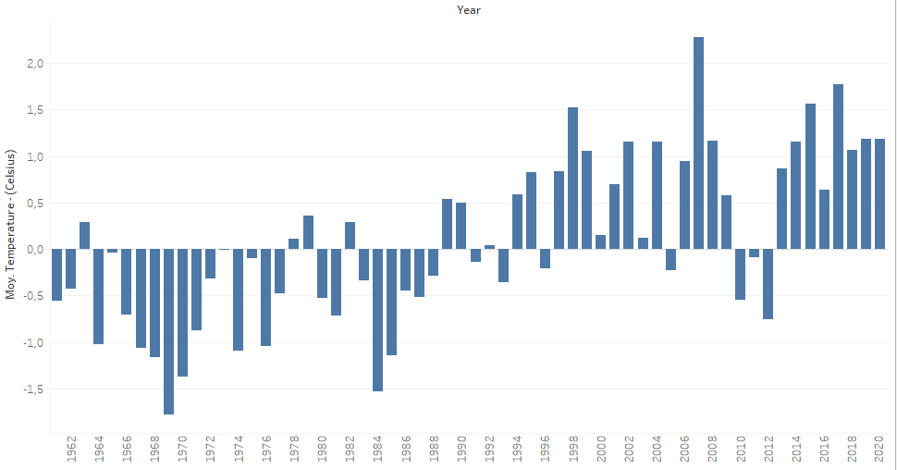
Average temperature per year since 1960
1

Slide 9
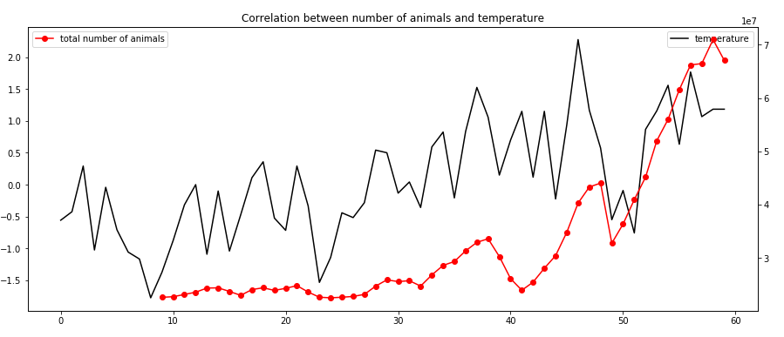
Correlation between average temperature per year and total number of animals
2
Correlation coefficient of temperature and total number of animals is 0.8436

Slide 10
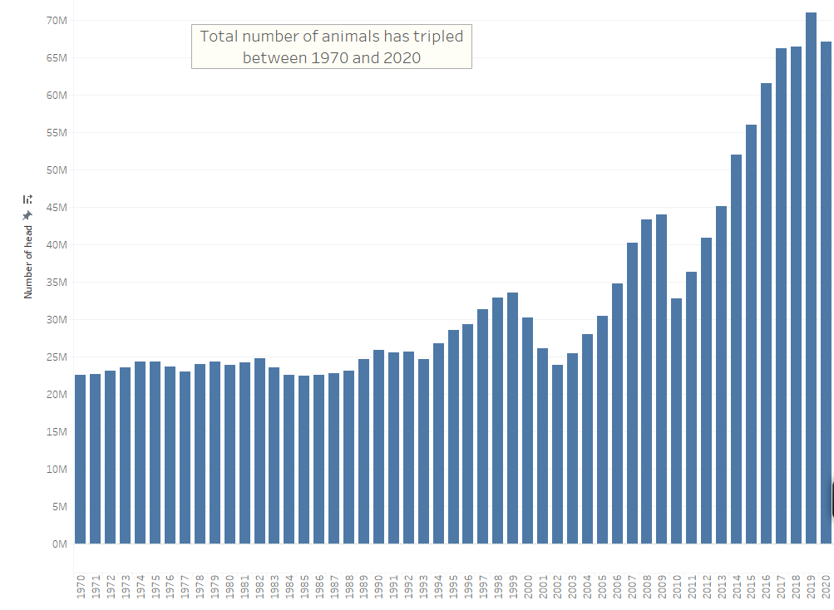
Rise of total number of animals between 1970 and 2020
3

Slide 11
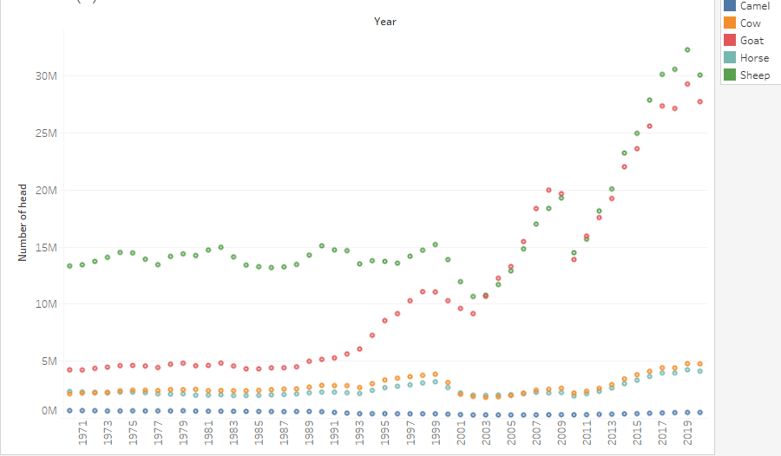
Rise of number of animals per type of animal between 1970 and 2020
3

Slide 12
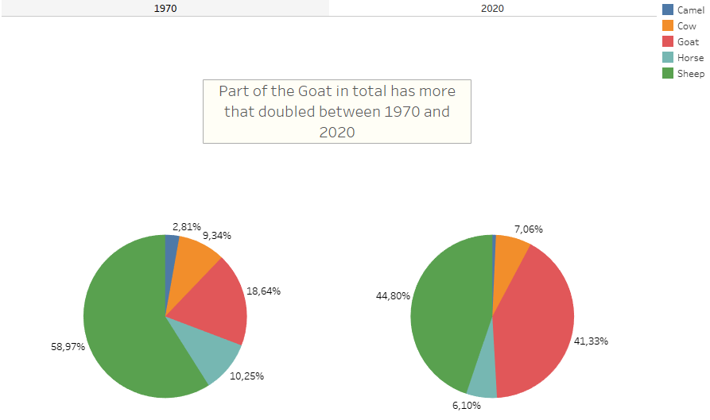
Part of goat in total number of animals 1970 vs 2020
3

Slide 13
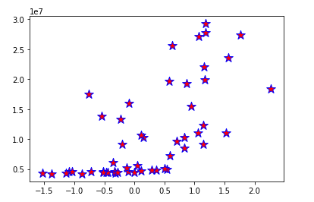
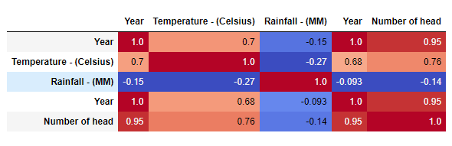
Correlation between number of goats and average temperature per year
4

Slide 14
To conclude …
Difficulties
Credits
Retrieve data from multiple website
Volume of dataset
Translate data into english
Merge several tables with different structure to create one dataset
Structured analysis
Use of statistical methods recently learnt
Want to go further

Slide 15
Going further …
Analysing data by region
Analysing economical data (rise of goat)
Analysing industrial data (rise of temperature)

